Slide 1
Project 1 – Solarwinds Cyberattack CYBR – 644 Cyber Practitioner Development Lab
Shrutika Joshi – HA72777 Ramatoulaye Sidibe- KB46813

Slide 2
What is Solarwinds Attack
The solarwind is a distinguished American software enterprise specializing in developing computer networks and information technology solutions
The solarwinds attack discover in December 2020, was a sophisticated cyber espionage campaign, wherein hackers targeted solarwinds by deploying malicious code into its Orion monitoring and management software which is a Network Management System (NMS) used by thousands of enterprises and government agencies worldwide.
NMS is a prime targets of attacker as it can communicate to all devices being managed and monitored. So any changes NMS can make, attacker can too.
Malicious actors managed to introduce a backdoor named ‘SUNBURST’ into software updates for Orion, leading to one of the most significant breaches in the cybersecurity history.
Many cybersecurity researchers and U.S. government officials have attributed the attack to APT29, also known as "Cozy Bear" or "The Dukes."

Slide 3
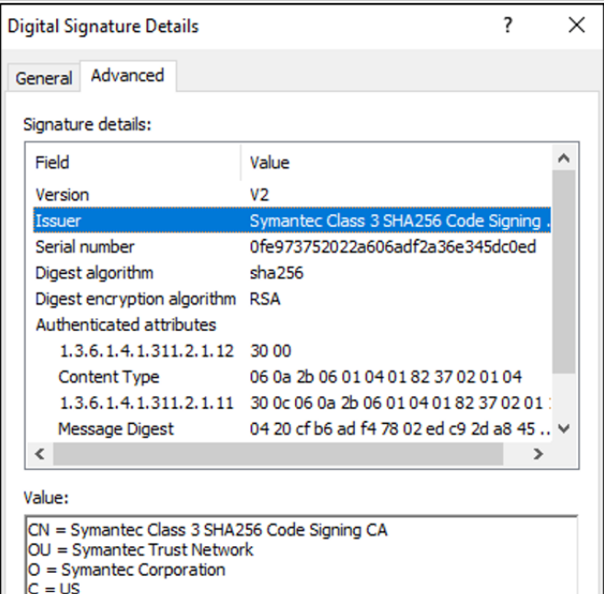
How the Attack planned & Implemented
SolarWinds.Orion.Core.BusinessLayer.dll is a SolarWinds digitally-signed component of the Orion software framework that contains a backdoor that communicates via HTTP to third party servers.
As per Solarwinds, Malware was deployed as part of an update from Solarwinds own servers and was digitally signed by valid digital certificate bearing their name. This points to supply chain attack.
The certificate was issued by Symantec with serial number 0fe973752022a606adf2a36e345dc0ed.
Fireeye tracked this trojanized version of this
SolarWinds Orion plug-in as SUNBURST.

Slide 4
How the Attack planned & Implemented
After an initial dormant period of up to two weeks, it retrieves and executes commands, called “Jobs”, that include the ability to transfer files, execute files, profile the system, reboot the machine, and disable system services
The malware disguises its network traffic as the Orion Improvement Program (OIP) protocol and stores reconnaissance results within legitimate plugin configuration files allowing it to blend in with legitimate SolarWinds activity.
The backdoor uses multiple obfuscated blocklists to identify forensic and anti-virus tools running as processes, services, and drivers.
Multiple trojanzied updates were digitally signed from March - May 2020 and posted to the SolarWinds updates website, including:
hxxps://downloads.solarwinds[.]com/solarwinds/CatalogResources/Core/2019.4/2 019.4.5220.20574/SolarWinds-Core-v2019.4.5220-Hotfix5.msp

Slide 5
How the Attack planned & Implemented
Once the update is installed, the malicious DLL will be loaded by the legitimate SolarWinds.BusinessLayerHost.exe or SolarWinds.BusinessLayerHostx64.exe
After a dormant period of up to two weeks, the malware will attempt to resolve a subdomain of avsvmcloud[.]com. The DNS response will return a CNAME record that points to a Command and Control (C2) domain. The C2 traffic to the malicious domains is designed to mimic normal SolarWinds API communications.
Attackers deployed a previously unseen memory-only dropper which is TEARDROP to deploy Cobalt Strike BEACON.
Attackers also used supernova, a malicious webshell backdoor.
Process Information
file_operation_closed
file-path*: “c:\\windows\\syswow64\\netsetupsvc.dll
actor-process:
pid: 17900
Window’s defender Exploit Guard log entries: (Microsoft-Windows-Security-Mitigations/KernelMode event ID 12)
Process”\Device\HarddiskVolume2\Windows\System32\svchost.exe” (PID XXXXX) would have been blocked from loading the non-Microsoft-signed binary
‘\Windows\SysWOW64\NetSetupSvc.dll’

Slide 6
Systems Impacted
Solarwinds Orion platform versions 2019.4 through 2020.2.1 released between March 2020 and June 2020
Solarwinds has over 300,000 customers and majority hitters are US Federal government including Department of Defense, 425 of the US Fortune 500, and lots of customers worldwide.
CVE Details
CVE-2020-14005: Unauthenticated API commands vulnerability.
CVE-2020-10148: Authentication bypass in the Orion API.
CVE-2021-25274: Vulnerability that could allow server compromise.
CVE-2021-25275: Privilege escalation vulnerability.
CVE-2021-25276: Circumvention of the activation form.

Slide 7
What Could Have Prevented the SolarWinds Attack?
The US Cybersecurity Infrastructure Agency highlighted few points which could have prevented Solarwainds Attack:
configuring firewalls to blocked all outbound connections from the servers running SolarWinds – servers that don’t need to connect to the internet should be prevented from connecting to the internet.
Blocking SolarWinds Orion servers from outbound internet traffic
Other than this
Implementing Zero-trust architecture
Advanced monitoring tools to detect anomalies within network
Enforcing two factor authentication like MFA across all critical domains
Regular security audits of the infrastructure could have identified the vulnerabilities or any of the suspicious activities happening inside the company network
Proper segmentation of the network may have limit the lateral movement

Slide 8
Published Remediation's and Patches
SolarWinds provided two hotfix updates on December 14 and 15, 2020, that contained security enhancements.
SolarWinds issued a new release (2020.2.1 HF 2) that replaces the compromised component and secures the installation.
Evaluated system integrity and audit logs for indicators of compromise;
Disconnected affected systems from the networks
Applied security patches to affected systems.
Block specific external DNS domains, based on guidance by Cybersecurity and Infrastructure Security Agency
Applied mitigation scripts to affected systems, as recommended by SolarWinds

Slide 9
References
Zurier, S. (2022, June 21). Could better cyber hygiene have prevented the SolarWinds attack? SC Magazine. https://www.scmagazine.com/news/could-better-cyber-hygiene-have-prevented-the-solarwinds-attack
FireEye. (2020, December 13). Evasive attacker leverages SolarWinds supply chain compromises with SUNBURST backdoor. Mandiant. https://www.mandiant.com/resources/blog/evasive-attacker-leverages-solarwinds-supply-chain-compromises-with-sunburst-backdoor
Satter, R. (2021, June 22). SolarWinds hackers could have been waylaid by simple countermeasure, U.S. officials. Reuters. https://www.reuters.com/technology/solarwinds-hackers-could-have-been-waylaid-by-simple-countermeasure-us-officials-2021-06-21/
Lee, R. D., Mancusi, M. A., Hay, A. A., & Raglani, A. (2021, June 11). Lessons learned from the SolarWinds cyberattack. Arnold & Porter. https://www.arnoldporter.com/en/perspectives/advisories/2021/06/lessons-learned-from-the-solarwinds-cyberattack

